Slide 1
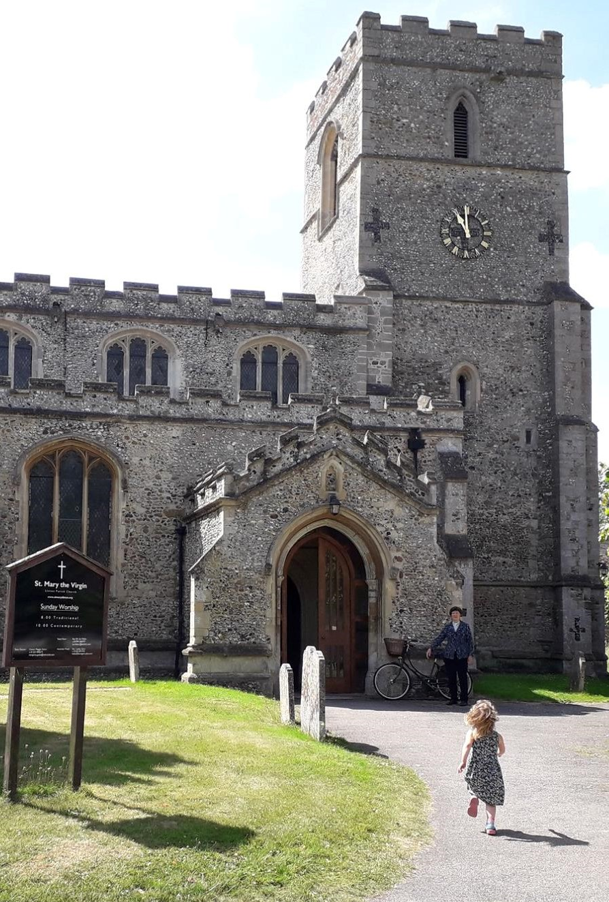
Giving 2020
St Mary’s, Linton

Slide 2
Thank you…
…to over 80 members of the church who give regularly
for a year on year increase in our giving since 2016
to the “Friends of St Mary’s” who relieve us of much of the burden of maintaining the building and fabric
Notes:
Any analysis of giving in the church must begin with ‘thank you’s.
Firstly to the over eighty members of the congregation who give in a regular planned way. Without such dedicated generosity St Mary’s would not be able to function in anyway whatsoever.
Secondly that the giving has increased year on year since 2017
Thirdly to the ‘Friends of St Mary’s’ whose generosity over the years has meant that we have not had to fund raise for major building work and repairs. Without this burden St Mary’s has been able to look beyond to the wider community.

Slide 3
The vision
Notes:
Our vision is shown in this design which appears on our website, our noticeboard, our stationery. That we as a church stand rooted in God and rooted in our community.
We are rooted in God. He created us in His own image as active, creative, social beings. He has redeemed us, giving Himself completely to save us from our faults. He sustains us day by day in this world that is still so beautiful despite what mankind as its stewards has done to it.
We are rooted in Community. He surrounds us with family and friends to love and be loved by.
We have a beautiful church to worship in; which a number of people in the village appreciate even if they do not come to services. We are surrounded by a small, attractive village which still manages to sustain a life of its own with its own schools, shops, pubs, hairdressers, fire station, cafés, doctors’ surgery and public transport. We benefit from all of these facilities.
We stand in the gap between God and the community of Linton.
We bring God to the community around us by our witness and service to the people in it. We are rooted in our God.
We represent our Community and its concerns to God through our prayers and identification with it. We are rooted in that Community. This is our vision for our place here.

Slide 4
Rooted in God. Rooted in Community
Mission Action Plan
PCC finance budget process
The choice
Notes:
The practical expression of this vision was worked out some years ago, when the PCC and the congregation worked together to devise a Mission Action Plan to better help the church realise this vision.
Over the past two years we have sought to implement it and we review it annually at the APCM.
This year those concerned with areas of the plan were asked what would it cost next year to realise our vision in their area of responsibility and to submit budget proposals accordingly as part of the overall church budget planning.
During this process it became increasingly clear that we were either going to have to go forward in faith, envisaging a deficit but not limiting what we felt was the work of God here, or we were going to have to severely curtail that work.
In order to achieve what was felt necessary the Finance Committee has proposed a deficit budget of £15,000.
The church has the resources to cover this from its reserves, but we cannot rely on using these in future. This is not a viable long-term course of action.
However, to achieve this we need individuals to give generously of their time, talents and money so that they can be directed towards this common purpose.
Many of us give generously of our time and talents but struggle with giving generously, sacrificially even with our money.
If we are to support the work of God here, day by day, year by year then we must be prepared to give more financially on a daily, weekly, monthly, yearly basis.
This £15000 does not allow for expansion of the work. For example, were we to employ a Children and Families worker to maintain and develop the work that we do with Children and Families, in Tots in Tow, Messy Church, Friday school services, Rooted, it would likely be £17,500 more.
This £15000 deficit could be covered by each member of the regular giving schemes increasing their giving by £4 a week.
Whilst it would meet our immediate needs it is not necessarily the correct response for everyone since some are already giving sacrificially and it would be inappropriate for them to put themselves in debt to cover this.

Slide 5
Other factors
In 2016 income higher due to grants and gifts received.
Income shows a steady rise since 2017.
Running costs have increased year on year
Notes:
The income in 2016 was much higher than in 2017. This is because we held a gift day and received a number of one-off gifts and grants for projects such as the Peace Garden which altogether raised an additional £19000.
Taking that into account our income has increased year on year.
However our costs have risen more, driven by our desire to realise our vision in the village.
Of our expenditure more than 70% are due to running costs over which we have no real power. These are things like the usual bills of heating, lighting and water as well as the Parish Share, which pays for clergy, housing, salaries, national insurance and pensions.

Slide 6
Why do we give to the Church?
… Because God has given us so much
… As a token of our thanks for all that has been given to us
… To further the work of the church
Notes:
Because God has given us so much
… As a token of our thanks for all that has been given to us.
… To further the work of the church

Slide 7
How much should I give?
Something only we can judge for ourselves
Giving in proportion to what we have received
‘On the first day of every week, each of you is to put aside and save whatever extra you earn’
~ 1 Corinthians 16v2
Notes:
Something only we can judge for ourselves
Giving in proportion to what we have received
The early church and Christians throughout the ages have responded by giving in proportion to what they received.
‘On the first day of every week, each of you is to put aside and save whatever extra you earn.’ 1 Corinthians 16v2

Slide 8
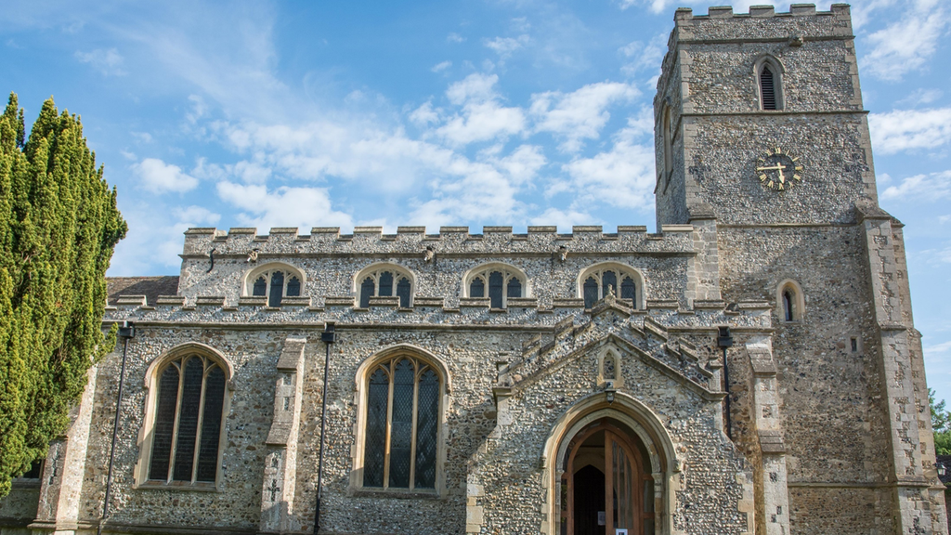
‘Each of you must give as you have made up your mind, not reluctantly or under compulsion, for God loves a cheerful giver. 8 And God is able to provide you with every blessing in abundance, so that by always having enough of everything, you may share abundantly in every good work.’
~ 2 Corinthians 9v7-8
Notes:
Elsewhere Paul wrote
‘Each of you must give as you have made up your mind, not reluctantly or under compulsion, for God loves a cheerful giver. ⁸ And God is able to provide you with every blessing in abundance, so that by always having enough of everything, you may share abundantly in every good work.’ 2 Corinthians 9v7-8

Slide 9
How much should I give?
Cost of one coffee out a week
Cost of a bottle of wine a week
Cost of lunch out, once a week
Notes:
One way to look at it is to ask yourself could you increase your giving by the
cost of having a coffee out weekly,
or perhaps by the cost of a bottle of wine
or a meal out.
Which, if any, of these levels feels appropriate is something that only you can judge.

Slide 10
How much should I give?
Biblical tithe of 10%
Church of England recommendation in 2009 of 5% of income
The equivalent of 1 hour’s paid work a week
Only the individual can judge for themselves what is appropriate
Notes:
In biblical times the tithe was 10% of income.
This may be unreasonable for many these days with costs of mortgages and childcare and so on.
10 years ago, the Church of England urged that parishioners think in terms of 5% of income.
More recently the idea, for those in work, of giving one hours pay weekly has been suggested.
Which, if any, of these levels feels appropriate is something that only you can judge.

Slide 11
Next steps
Pray for the money to come in
Prayerfully review your own giving
Notes:
Pray that the money will come in, that He will multiply these gifts to His service
Prayerfully review your own giving. We used to say ‘All things come from You and of Your own have we given You.’ What would be an appropriate token gift to express our thanks for all that He has given us?
What would be the appropriate level of response for all that He has given us?

Slide 12
Consider changing how you give
Do you shop online?
Consider joining ‘Give as You Live’
Do you put money in the collection on the weeks you are here?
Consider joining the weekly envelope scheme so that you can put money aside even in the weeks you are not here.
Notes:
Another thing to Consider is the way in which we give.
Do you shop online?
You could consider joining ‘Give as You Live’ which makes a donation to your chosen charity for each online transaction. What’s more it costs you nothing, the money is raised from the people you have bought from.
Do you put money in the collection each time you are at St Mary’s?
Could you consider giving in a planned fashion, putting some money aside week by week using the envelope scheme.
.

Slide 13
Consider changing how you give
Consider joining the Parish Giving scheme or making regular donations by standing order or direct debit instead
Do you use the weekly envelope scheme?
Are you a tax payer?
Make sure that your giving is Gift Aided so that we can reclaim the tax paid on it.
Notes:
If you already use the envelopes, could you perhaps consider joining the Parish Giving Scheme, giving by direct debit. This allows us to collect the gift aid monthly and you can, if you wish, inflation proof your gift
If you are a taxpayer, have you planned your giving but not Gift Aided it yet? The church can increase the size of your gift with little impact to you by being allowed to reclaim tax against your donation.

Slide 14
Done all of the above?
Prayerfully consider how much you give as a percentage of your income. Is it enough?
Consider making a one-off gift
Consider making a legacy in your will to the church
Notes:
If you are someone who makes planned, regular giving, in a tax efficient way have you considered your donation as a percentage of your income? Could you, should you increase that percentage?
Consider a one-off gift, perhaps in gratitude for something specific that God has done for you.
Consider making provision for the church in your will. It’s not something that we feel comfortable talking about. Be assured that I would much rather have you here with us. However, when the time comes, a legacy would be lovely way to remember you until we are together again.

Slide 15
Giving 2020
Leaflets available with more details
Thank you for listening
Notes:
Leaflets are available with more details and a form to express your response and ask for more information.
Thank you for listening.

